Slide 1
Ann Arbor Trail Welcome to the 2020-2021 School Year
Band & Music Kenneth Gill
Physical Education & Health Elizabeth McCreedy

Slide 2
Ann Arbor Trail Magnet School Band & Music
Kenneth Gill
kenneth.gill@detroitk12.org

Slide 3
Music Program Overview
General Music Grades K - 8th
Band Grades 4^{th -} 8th
Vocal Ensemble Grades 4^{th -} 8th

Slide 4
DPSCD Music Curriculum Kindergarten
Module 1
Memorize Songs from Diverse Cultures
Module 2
Memorize Songs from Diverse Cultures - 2
Module 3
Pitch & Dynamics
Module 4
Tempo & Duration
Module 5
Rhythmic Instruments
Module 6
Melodic Instruments
Module 7
Respond With Body Movements
Module 8
Willingness To Participate

Slide 5
DPSCD Music Curriculum Grade 1
Module 1
Tone Quality And Range
Module 2
Dynamics And Pitch
Module 3
Maintaining Steady Beat
Module 4
Fast, Slow, Short, And Long
Module 5
Musical Concepts For A Purpose
Module 6
Expressive Qualities
Module 7
Songs From Various Cultures
Module 8
Instruments of Various Cultures

Slide 6
DPSCD Music Curriculum Grade 2
Module 1
Music In Everyday Life
Module 2
Perform Individually And Collectively
Module 3
Perform Individually And Collectively - 2
Module 4
Interpret Basic Music Terms And Symbols
Module 5
Perform Individually And Collectively - 3
Module 6
Interpret Basic Music Terms And Symbols - 2
Module 7
Perform Drama And Pantomime To Music
Module 8
Feelings And Moods Expressed Through Music

Slide 7
DPSCD Music Curriculum Grade 3
Module 1
Rounds And Pattern Songs
Module 2
Form And Structure For Performance
Module 3
Simple Sight-Reading Skills
Module 4
Dynamics, Tempo And Articulation In Performance
Module 5
Various Types Of Music Are Used For Various Occasions
Module 6
Music Connects To And Is Influenced By Special Interests, Experiences, Or Purposes
Module 7
Create (Compose) Music Using Technology
Module 8
Present Original Composition To Others. Describe Connection To Express Intent

Slide 8
DPSCD Music Curriculum Grade 4
Module 1
Musical Elements Are Used In Music From Various Cultures
Module 2
Perform Simple Parts Songs
Module 3
Recognize Characteristics Of Different Types Of Music
Module 4
Visually And Aurally Identify Orchestral Instruments
Module 5
Perform Individual Instrument Parts With Others Sing/Play Contrasting Parts
Module 6
Music From Various Cultures - 2
Module 7
Perform Simple Part Songs - 2
Module 8
Recognize Characteristics Of Different Types Of Music

Slide 9
DPSCD Music Curriculum Grade 5
Module 1
Differences And Similarities Between Culturally Diverse Music
Module 2
Perform Counter-Melodies And Simple Part Songs
Module 3
Interpret And Utilize Basic Music Terms And Symbols
Module 4
Forms In Various Musical Selections
Module 5
Evaluate Musical Works Citing Evidence Using The Elements Of Music
Module 6
Demonstrate Understanding Of The Structure And Elements Of Music Performance
Module 7
Read And Identify Standard Symbols For Musical Elements
Module 8
Demonstrate Musical Ideas, Expressing Content And Connection To Purpose And Context

Slide 10
DPSCD Music Curriculum Grade 6
Module 1
Compare And Contrast Music From Various Periods And Cultures
Module 2
Explain How The Structure And Elements Of Music Are Used In Performances
Module 3
Sing Two, Three And/or Four-Part Harmony
Module 4
Sing Simple Rhythmic, Melodic, And Harmonic Phrases Within AB And ABA Forms
Module 5
Sing Harmonic Patterns On Chords I, IV, And V7
Module 6
Play On Melody Bells Or Recorders Chords I, IV, V7
Module 7
Compose Music Using Technology
Module 8
Evaluate Your Work Applying Criteria

Slide 11
DPSCD Music Curriculum Grade 7
Module 1
Identify Instruments From Various Cultures And Ethnicities
Module 2
Relationship Between Music And The Arts, Other Disciplines, Contexts, And Daily Life
Module 3
Perform And Compose Music In Duple And Triple Meter
Module 4
Perform And Compose Music In Duple And Triple Meter - 2
Module 5
Perform Using Melodic Devices That Help Organize Musical Ideas
Module 6
Playing By Ear Simple Melodies On A Melodic Instrument
Module 7
Identify Musical Elements - Melody And Harmony
Module 8
Identify Musical Elements – Rhythm And Tone Color

Slide 12
DPSCD Music Curriculum Grade 8
Module 1
Identify Instruments From Various Cultures And Ethnicities
Module 2
Relationship Between Music And The Arts, Other Disciplines, Contexts, And Daily Life
Module 3
Perform And Compose Music In Duple And Triple Meter
Module 4
Perform And Compose Music In Duple And Triple Meter - 2
Module 5
Perform Using Melodic Devices That Help Organize Musical Ideas
Module 6
Playing By Ear Simple Melodies On A Melodic Instrument
Module 7
Identify Musical Elements - Melody And Harmony
Module 8
Identify Musical Elements - Rhythm And Tone Color

Slide 13
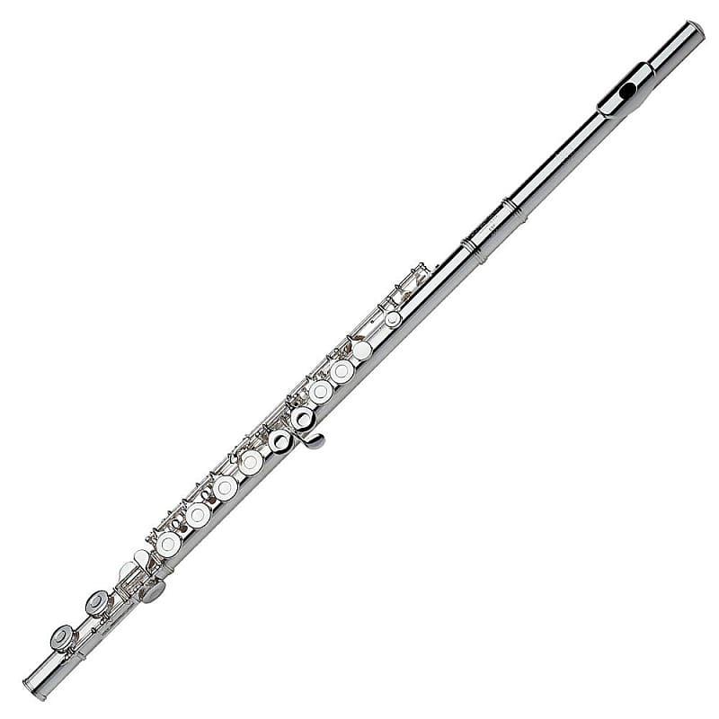
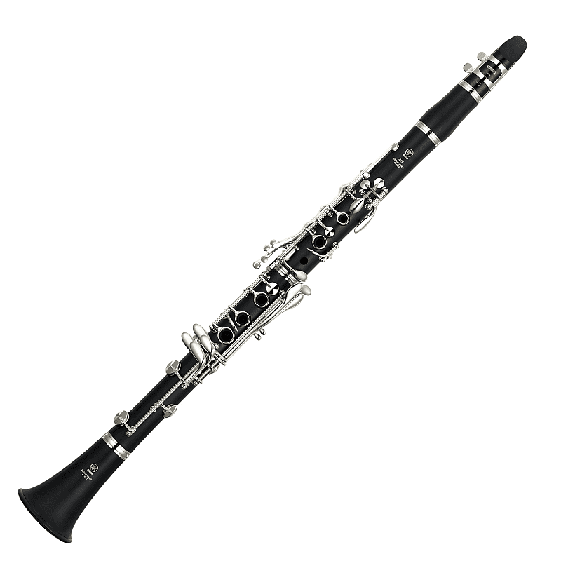
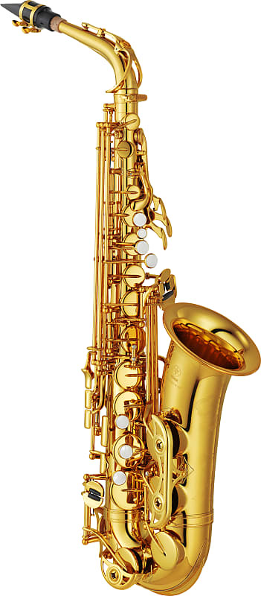
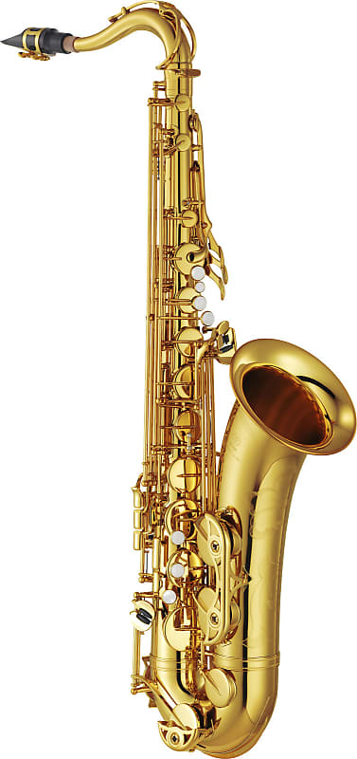
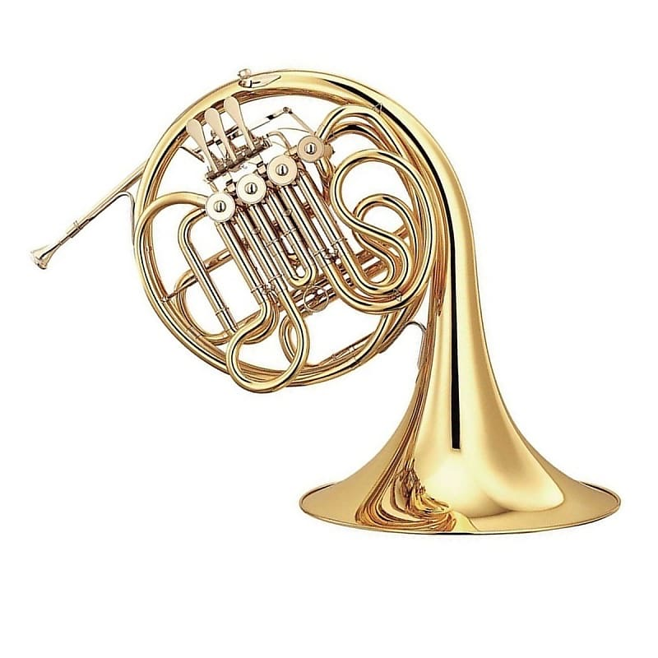
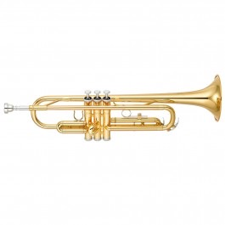
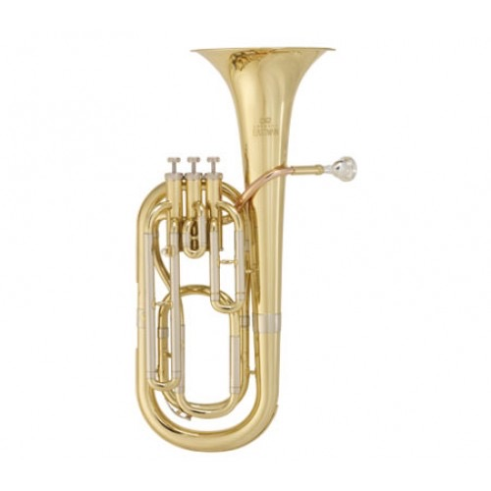
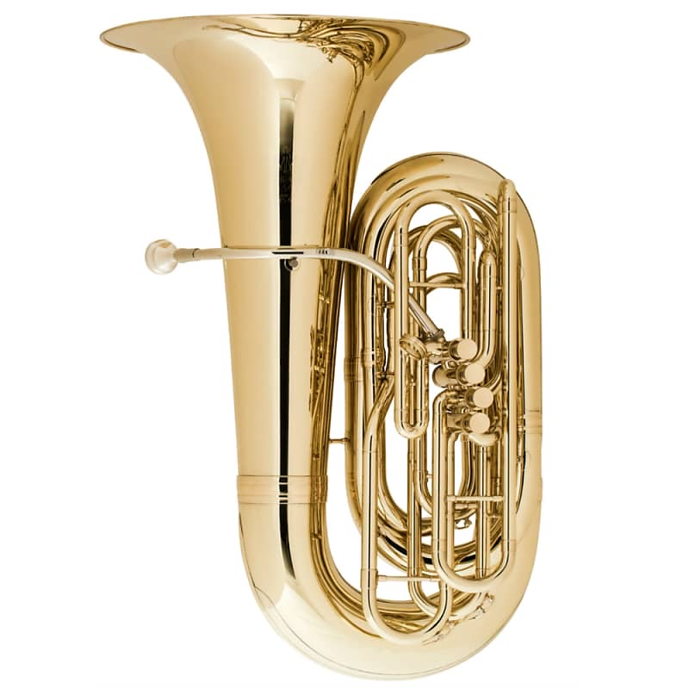
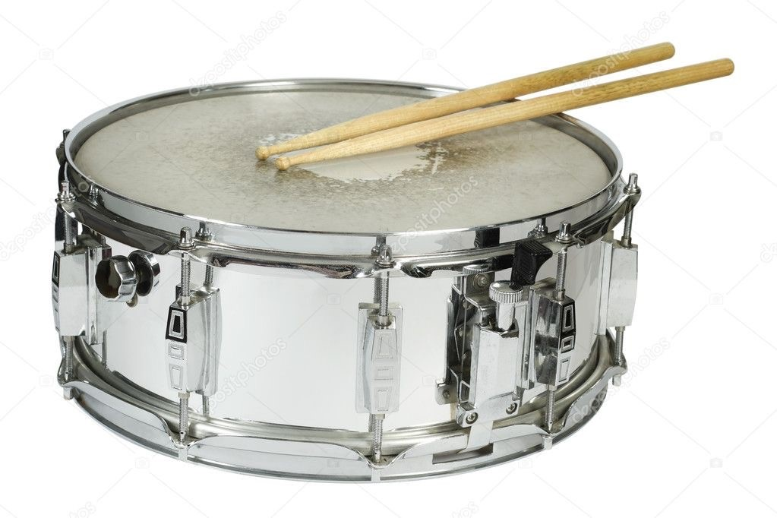
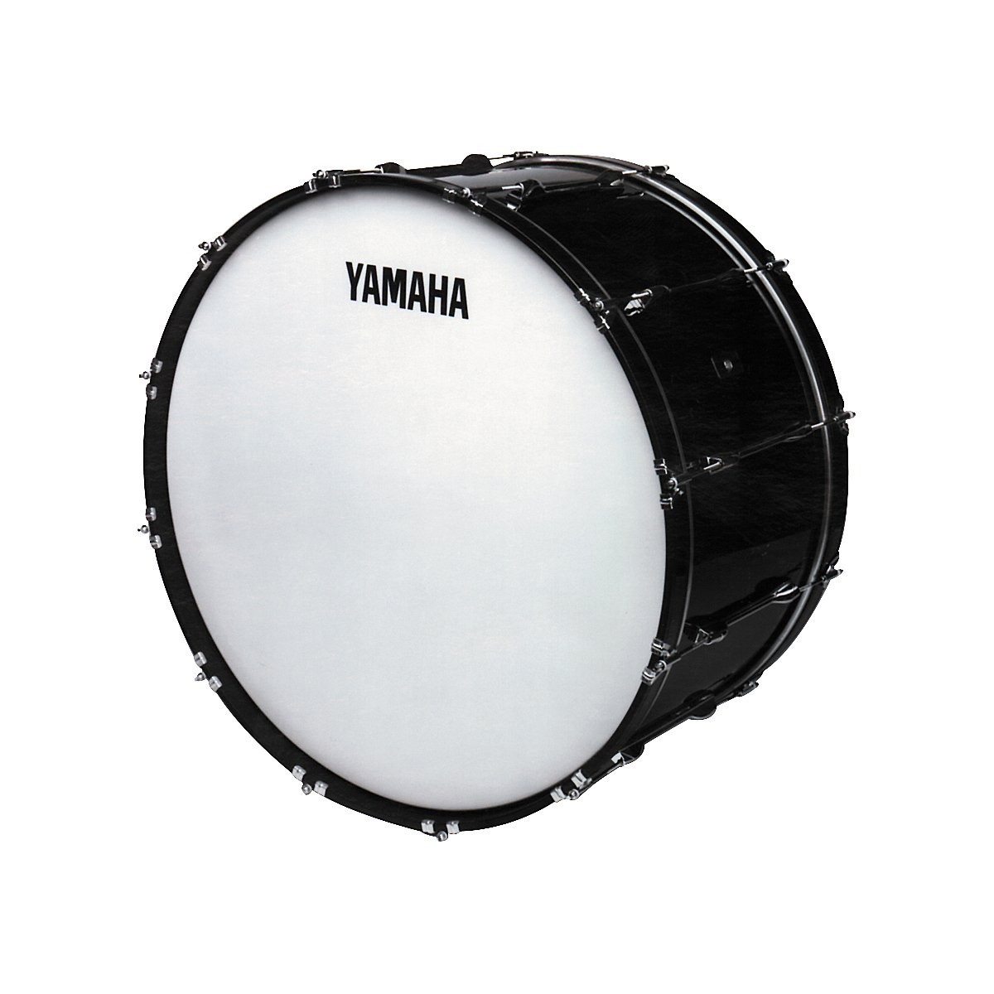
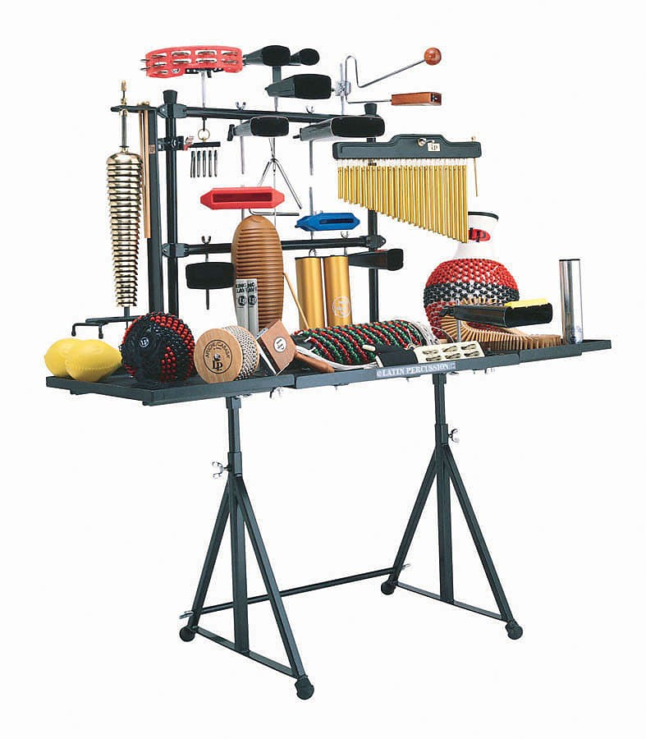
Band Instruments Offered
French Horn
Baritone Horn
Flute
Alto Sax
Tenor Sax
Trombone
Clarinet
Trumpet
Snare Drum
Bass Drum
Percussion
Tuba

Slide 14
Instrument Accessories Needed
Flute, Clarinet, Alto Sax and Tenor Sax
Reeds (Except Flute), Mouthpiece, Neck Strap, Cork Grease, Cleaning Cloth
French Horn, Trumpet, Trombone, Baritone Horn, Tuba
Mouthpiece, Valve/Slide Oil, Tuning Slide Grease, Polishing Cloth
Drums And Percussion
Drumsticks, Drum Pad, Mallets

Slide 15
 | Mr. Gill
7:40 - 8:32 | 8th Monday, Tuesday + Friday (Band) 7th Wednesday, Thursday + Friday (Band)
8:34 - 9:24 | 6th Monday, Tuesday + Friday (Band)
9:40 - 10:20 | 2nd Grade Tuesday and Thursday
10:20 - 11:10 | Lunch
11:10 - 12:00 | Office Hours Monday and Wednesday
12:00 - 12:45 | Kindergarten Monday and Wednesday + Friday A Week 1st Tuesday and Thursday + Friday B Week
12:45 - 1:30 | 3rd Tuesday and Thursday 4th Monday and Wednesday + Friday (Band)
1:45 - 2:30 | 5th Monday and Wednesday + Friday (Band)

Slide 16
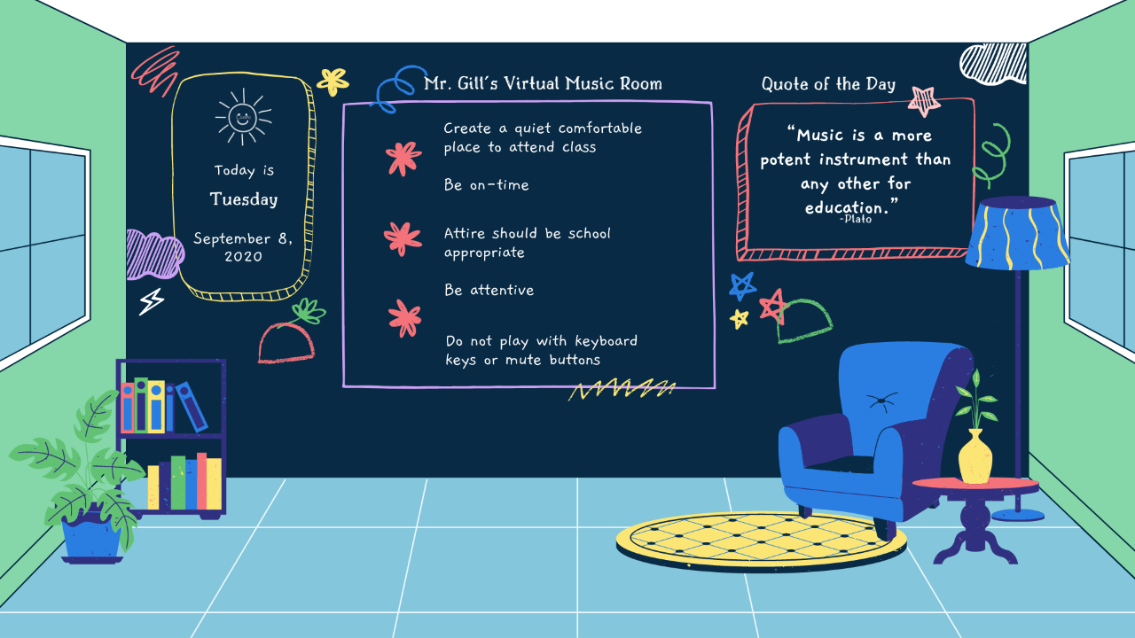

Slide 17
Platforms, Apps & Technology
Microsoft Teams
Schoology
Tik Tok
Acapella
Zoom
Adobe Premiere
Adobe Audition
iPhone Voice Recorder
iRig Interface
Focusrite Scarlett Solo Interface
iPad
iPhone

Slide 19
Ann Arbor Trail Magnet School Physical Education and Health
Elizabeth McCreedy
elizabeth.mccreedy@detroitk12.org

Slide 20
Physical Education and Health Virtual Classroom Rules
Attend every class: Arrive to class on time and stay for the entire class.
Dress appropriately: Show up properly dressed for class in a T-shirt and shorts or sweats.
Be prepared to participate: Participate in all activities and complete all assignments.
Be respectful of others: Be respectful of your fellow students and your teacher. Remember everyone is here to learn.

Slide 21
Physical Education and Health Expectations for Behavior in Class
Pay attention in class. You shouldn’t have a cell phone out or TV on in the background.
Raise your hand (by clicking on the hand in the middle of the screen) to be called on before speaking. Wait for teacher to call on you.
The teacher will mute all students unless they are called upon. Do not unmute yourself.

Slide 22
Physical Education and Health Setting Up a Learning Space
Physical Education
Have enough room to move: The space should be large enough to physically move around in (at least 6 feet by 6 feet).
Provide a soft space for exercises: Students should have something soft to do floor exercises on, such as carpet or a yoga mat.
Health
Make a space for focused learning: Students need a comfortable place to learn on their computers & tablets that is as free from distractions as possible.

Slide 23
Physical Education and Health Physical Education Learning Objectives
Stretching/warmups
Locomotor skills
Non-Locomotor skills
Aerobic exercise
Anaerobic exercise
Yoga
Dance

Slide 24
Physical Education and Health Health Learning Objectives
Safety
Hygiene
Substance Abuse
Nutrition
Physical activity

Slide 25
Physical Education and Health Class Schedule
7:40 – 8:32 AM | 7th (Monday & Tuesday) 8th (Wednesday & Thursday) 7th & 8th (Friday – Health & Nutrition)
8:34 – 9:24 AM | 6th (Wednesday & Thursday) 6th (Friday - Health/Nutrition)
9:40 – 10:20 AM | 2nd (Monday & Wednesday) 2nd (Friday – Health/Nutrition)
11:10 – 12:00 PM | Lunch
12:00 – 12:45 PM | Kindergarten (Tuesday & Thursday) 1st (Monday & Wednesday) Kindergarten & 1st (Friday – Health & Nutrition)
12:45 – 1:30 PM | 3rd (Monday & Wednesday) 4th (Tuesday & Thursday) 3rd & 4th (Friday – Health & Nutrition)
1:45 – 2:30PM | 5th (Monday & Wednesday) 5th (Friday – Health & Nutrition)

